Slide 1
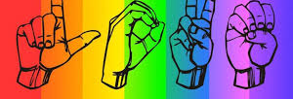
Charades
Ramsha Rasheed Fa16- BCS-127
Aisha Fa16-bcs-097
Bilal ahmed fa16-bcs-121
Supervisor
Dr. Usama Ijaz Bajwa

Slide 2
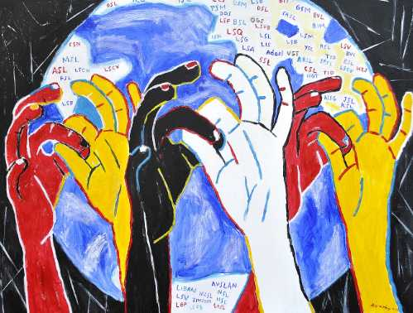
Introduction
Charades is a virtual sign language interpreter.
Android application.
Accommodates 2-way communication:
Sign-to-Text
Text-to-Sign

Slide 3
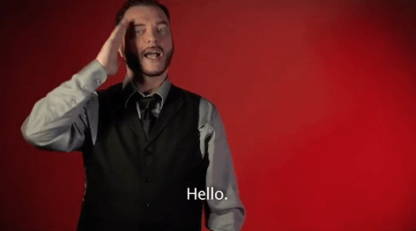
How do deaf communicate?
Through sign language.
People communicate through sign language.
Use professional interpreters to communication.

Slide 4
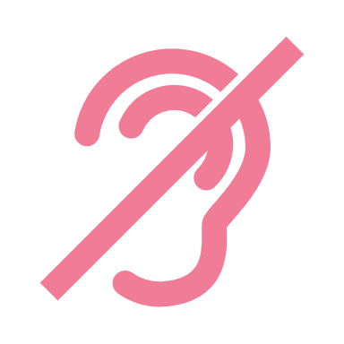
Problem
Sign language interpreter :
Expensive
Not accessible at all time.
Automated translators present for almost all the languages.
Google translate
No automated translator available for sign languages.
This causes a communication gap for > 466 million people around the world (432 million adults and 34 million children).

Slide 5
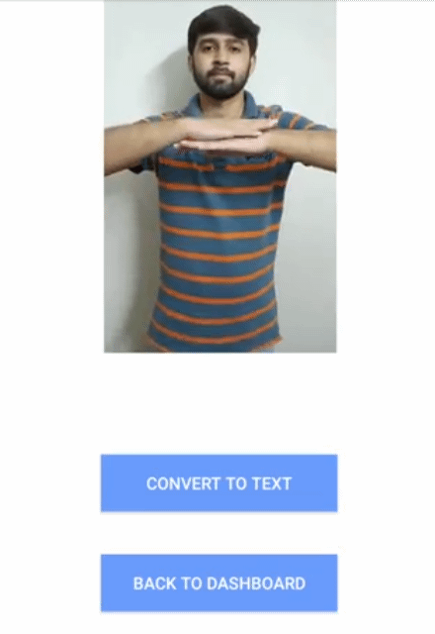
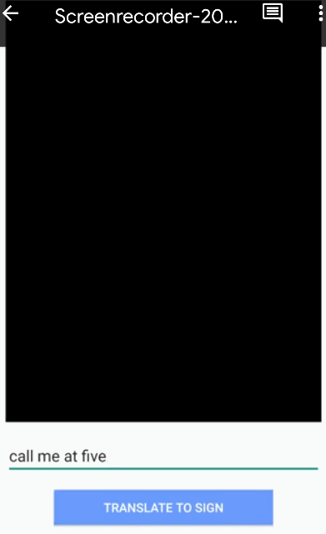
Features
Detects the sign performed by deaf person through camera
Translating signs into equivalent English sentence.
Abled person typing the English sentence for translation.
English sentence converted into corresponding signs and displayed on screen.

Slide 6
Related work
Augmented reality app that converts sign to speech and vice versa.
Not publicly available.
Only makes doctors appointments.
KinTrans
Uses stationed camera for recognition.
SignAll
Uses 4 cameras and installed in a booth.

Slide 7
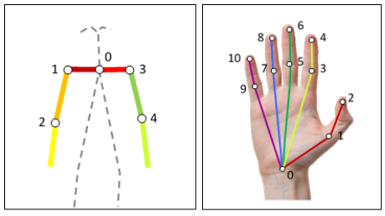
ASLLVD dataset The dataset focuses on 27 key points for sign language recognition and production.
Notes:
Our dataset focuses on these 27 key points in sign language recognition and production. Few of the key points are on face too. 11 for each hand and 5 for shoulder and arms.

Slide 8
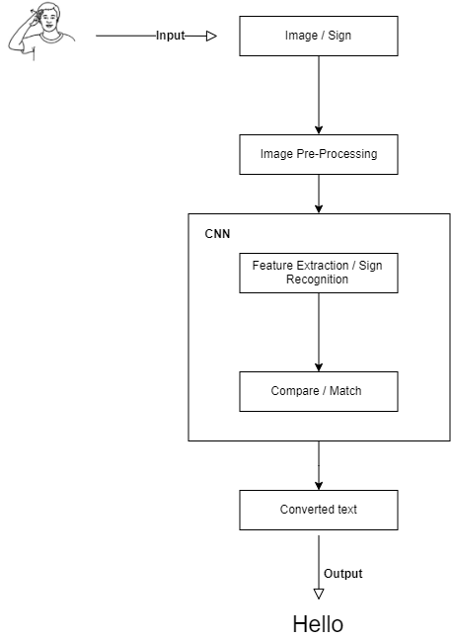
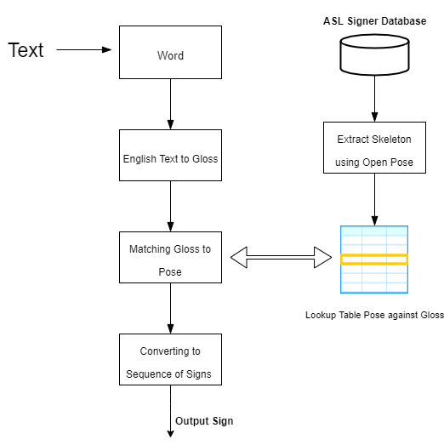
Sign-to-text
Text-to-sign

Slide 9
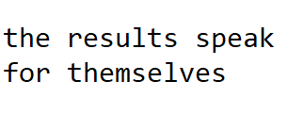
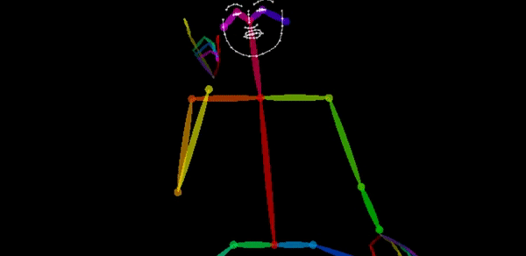
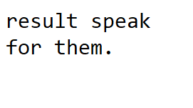
Text-to-Sign Module
Pipeline
Model
Lookup table
English
Gloss
Pose

Slide 10
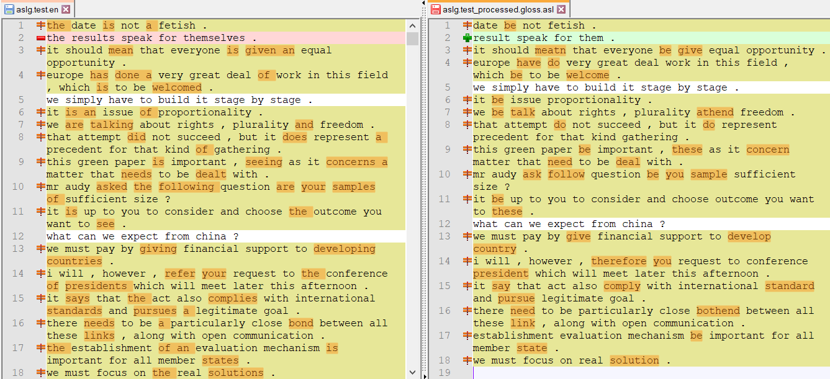
English-ASL Gloss Parallel Corpus 2012(83K examples)

Slide 11
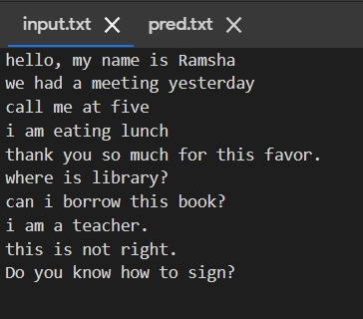
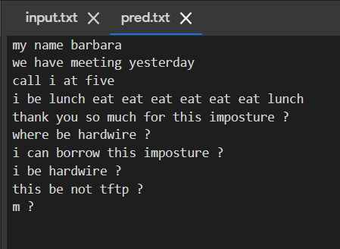
English → Gloss
Transformer model with shared GloVe Embedding, different number of heads and model dimension
English sentences
ASL Gloss
Sequence to Sequence

Slide 12
English → Gloss
BLEU evaluation matric is used.
Score is between 0 to 1 or sometimes normalized from 0 to 100.
Usually calculated on ~1000 sentences.
Notes:
BLEU(bilingual evaluation understudy) is an algorithm for evaluating the quality of text which has been machine-translated from one natural language to another.

Slide 13
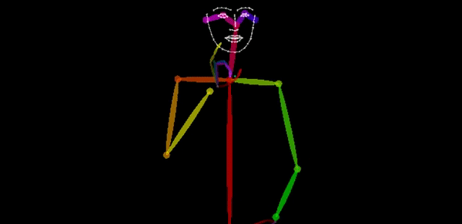
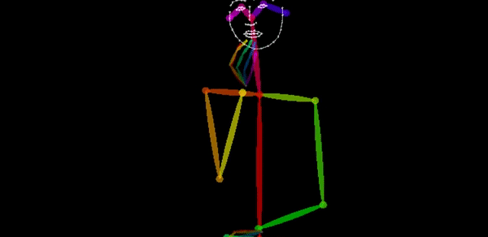
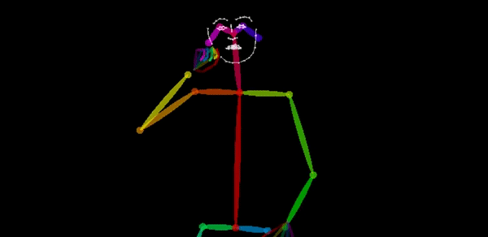
Gloss → Pose
I + ate + an apple
I + eat + apple
→
→

Slide 14
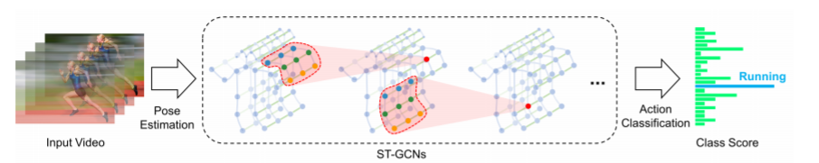
Sign-to-Text module
Pipeline
Sign in video
feature extraction
English word

Slide 15
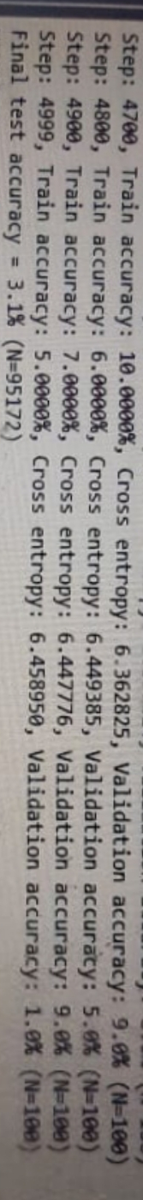
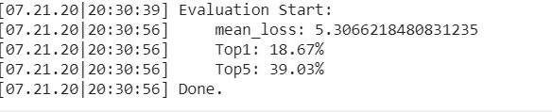
Evaluation results for 2745 classes using st-gcn model
Evaluation results for 2745 classes using CNN+RNN model
Notes:
Top 1 model’s accuracy and the top-5 accuracy, which corresponds to the accuracy based on the five most likely responses presented by the model

Slide 16
SWOT analysis
Strength
Easy to use.
Real-times translations.
Both way translation possible.
Weakness
Takes more than a minute to translate.
Recognition probability is less.
Opportunity
Can integrate more sign languages.
Increase accuracy by getting improved dataset.
Threats
Dataset availability
Lack of computational resources
Funding problems

Slide 17
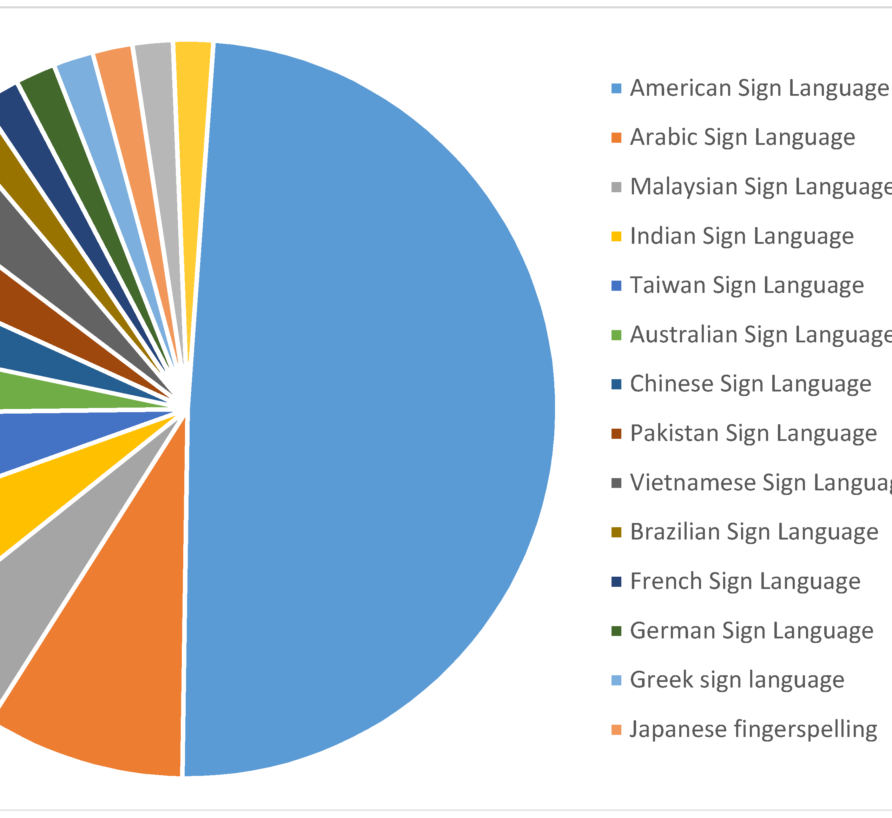
Challenges
Choosing sign language to target
International sign language not officially declared yet.
ASL most widely spoken among others.
Notes:
English-ASL gloss public datasets are small (< 100,000 sentence pairs) and of poor quality

Slide 18
Challenges
Technical challenges
For text-to-sign
Modern translation models use hundreds of millions of examples English-ASL gloss public datasets are small (< 100,000 sentence pairs) and of poor quality.
Dataset available has poor translations and was not all parallel.
Speed of video dataset was reduced.
For sign-to-text
ASLLVD dataset only has frontal view of the signer.
Lacks the 3D view.

Slide 19
Challenges
Engineering Challenges:
Computational extensive:
Sign-to-text model requires a Nvidia GPU with extensive memory for demo.
For overall project, a server system with good GPU and extensive memory is required.

Slide 20
Challenges
Android application
Can only work with .mp4 extension videos.
Can not port heavy models on android device.

Slide 21







Tools and Techniques

Slide 22
Thank You!

Slide 23
GitHub Links
https://github.com/mishu45/CharadesFYP

Slide 24
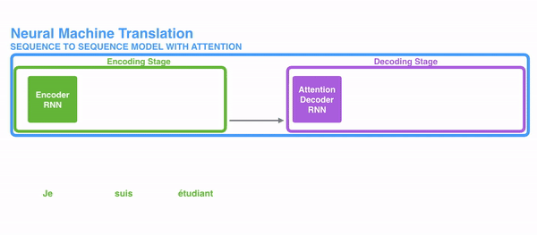
Sequence to sequence
Back

